Slide 1
Applying for a Job
USING THE SCHOOLSPRING APPLICANT TRACKING SYSTEM

Slide 2
CREATING YOUR PROFILE

Slide 3
Accessing the Application Site https://www.providenceschools.org/careers

Slide 4
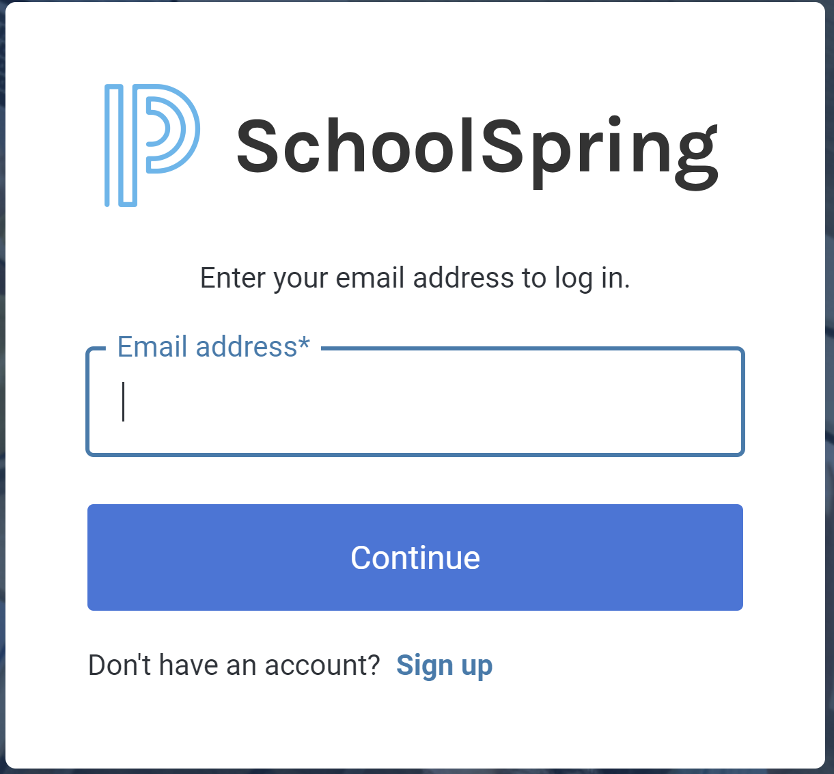
Creating your Account
Click Sign In / Register to start creating your account
If you have an account, enter your email, select Continue, then enter your SchoolSpring password
If you do not have an account, select Sign Up and enter your email address. When done successfully you will receive an email from “no reply” to verify your account. Once you click to verify you will be routed back to the main page where you will sign in with your account information.

Slide 5
When you are in your personal account your initials will appear in the upper corner of the page
Your Profile is where you can add more of your education and work experience to auto-populate into applications

Slide 6
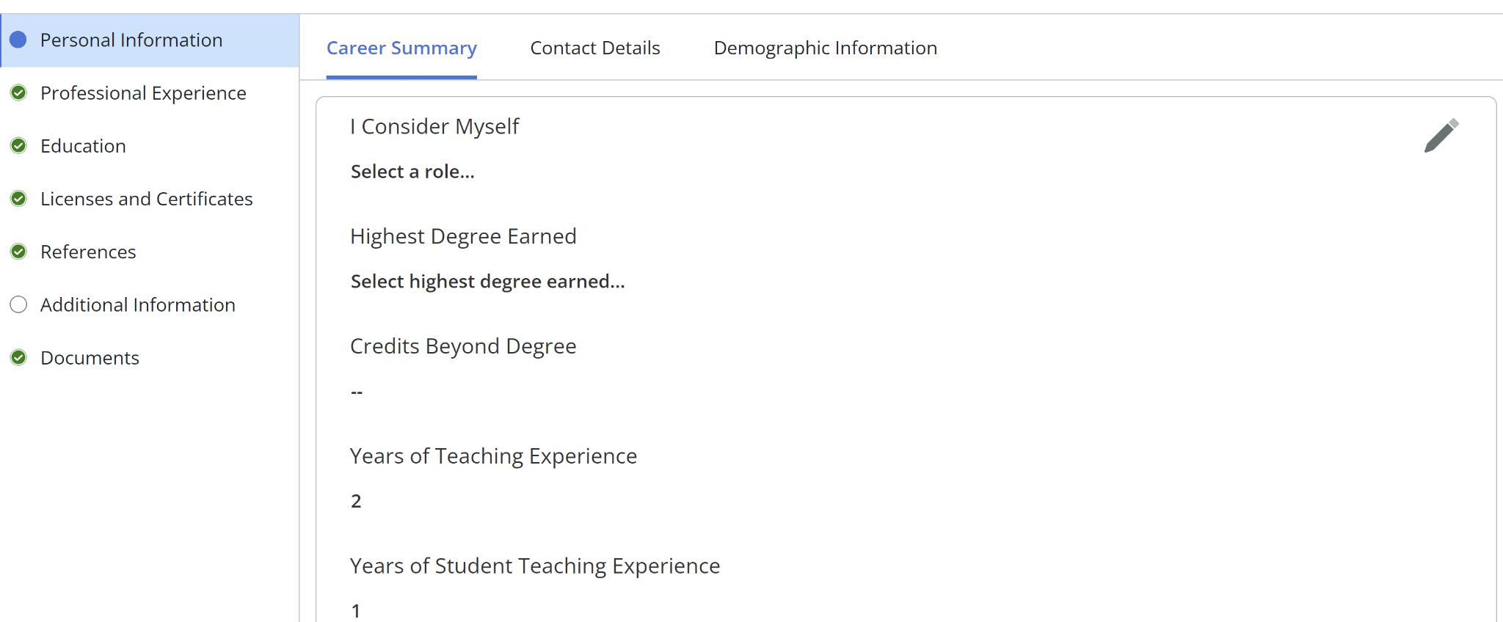
Each section allows you to enter personal information, work experience, education, certifications, references, additional info and any documents (such as Resumes, Cover Letters, Transcripts). Completing each section will allow you to automatically pull this information into applications.

Slide 7
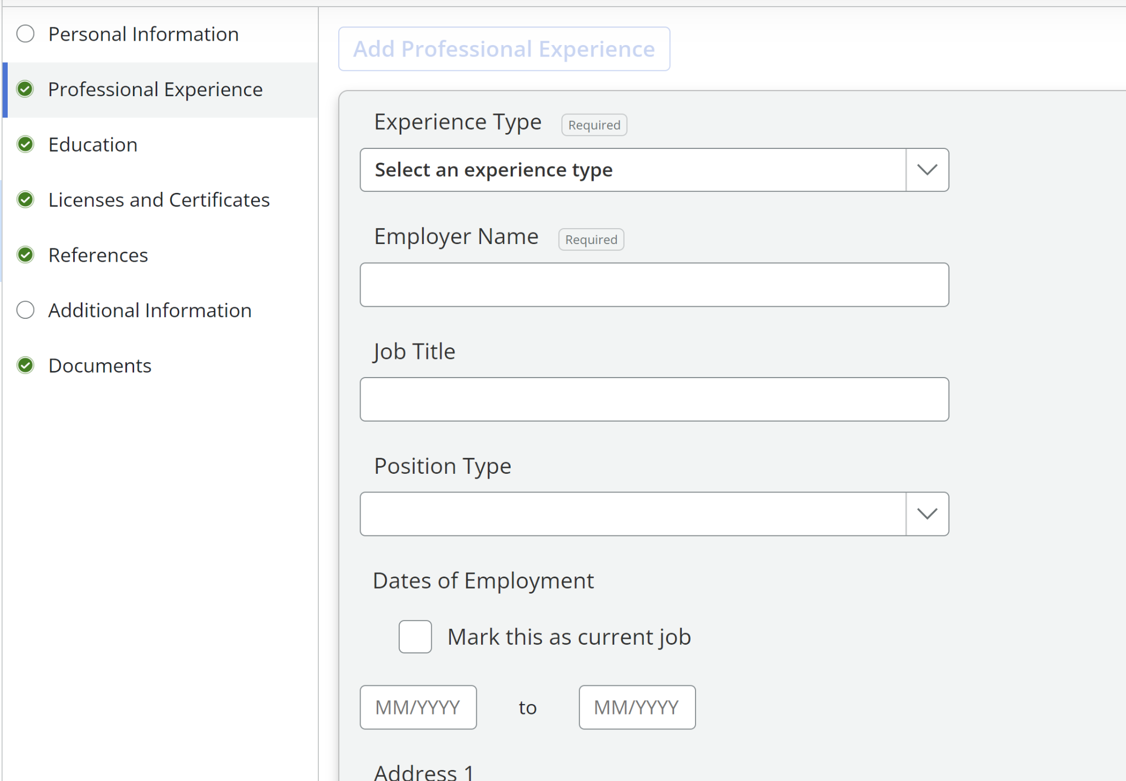
Some other areas will appear to be completely blank. You will click on Add button to enter your information.

Slide 8
LOOKING FOR POSITIONS

Slide 9
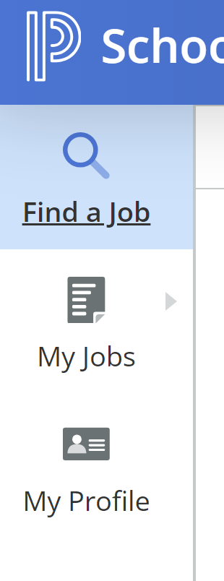
Clicking on the “Find a Job” from any page you are in will bring you back to the job postings. It is essentially your home button.

Slide 10
You can search for positions by typing in a keyword to search or by filtering by position type or location

Slide 11
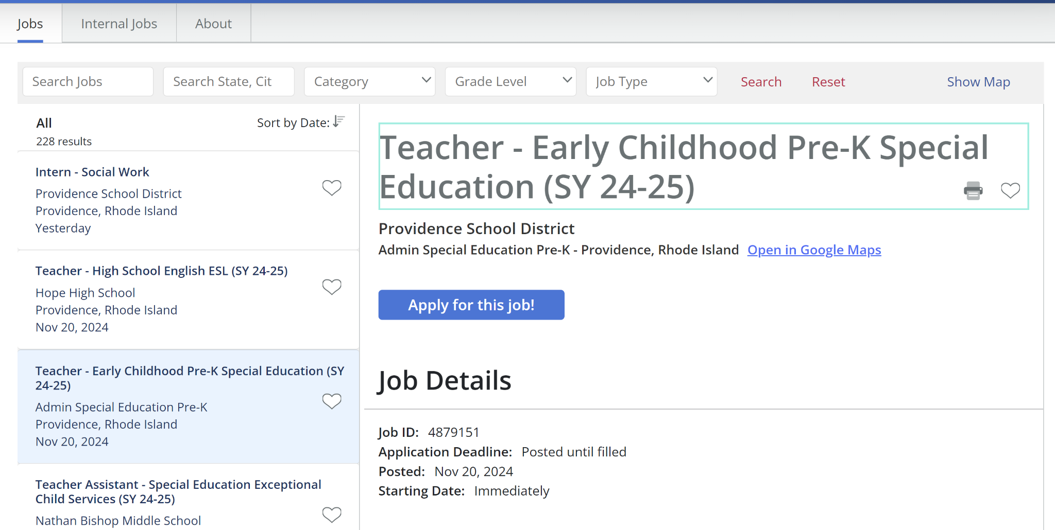
When you find a position of interest to you, click on the blue text to read the job description
When you click on the title the job description will slide in from the right of the screen. From here you can review the specifics of the position and if interested you can apply to the position.
When you are finished looking at the job description you can click “Show Map”. The open job description will slide away from view and you will be able to continue looking for positions.

Slide 12
APPLYING FOR POSITIONS

Slide 13
BEFORE YOU BEGIN
Have your final resume ready for upload
Have your cover letter(s) ready for upload
Have any other items you would like to submit with your application ready for upload. These are not required at this stage in the process but may include:
Teaching Certificate
Letters of Reference
Commendations
Transcripts
IMPORTANT: You MUST upload your resume for EACH position you are applying to.

Slide 14
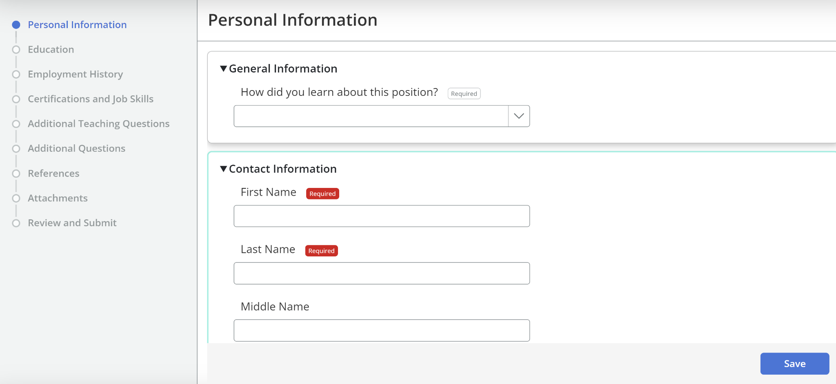
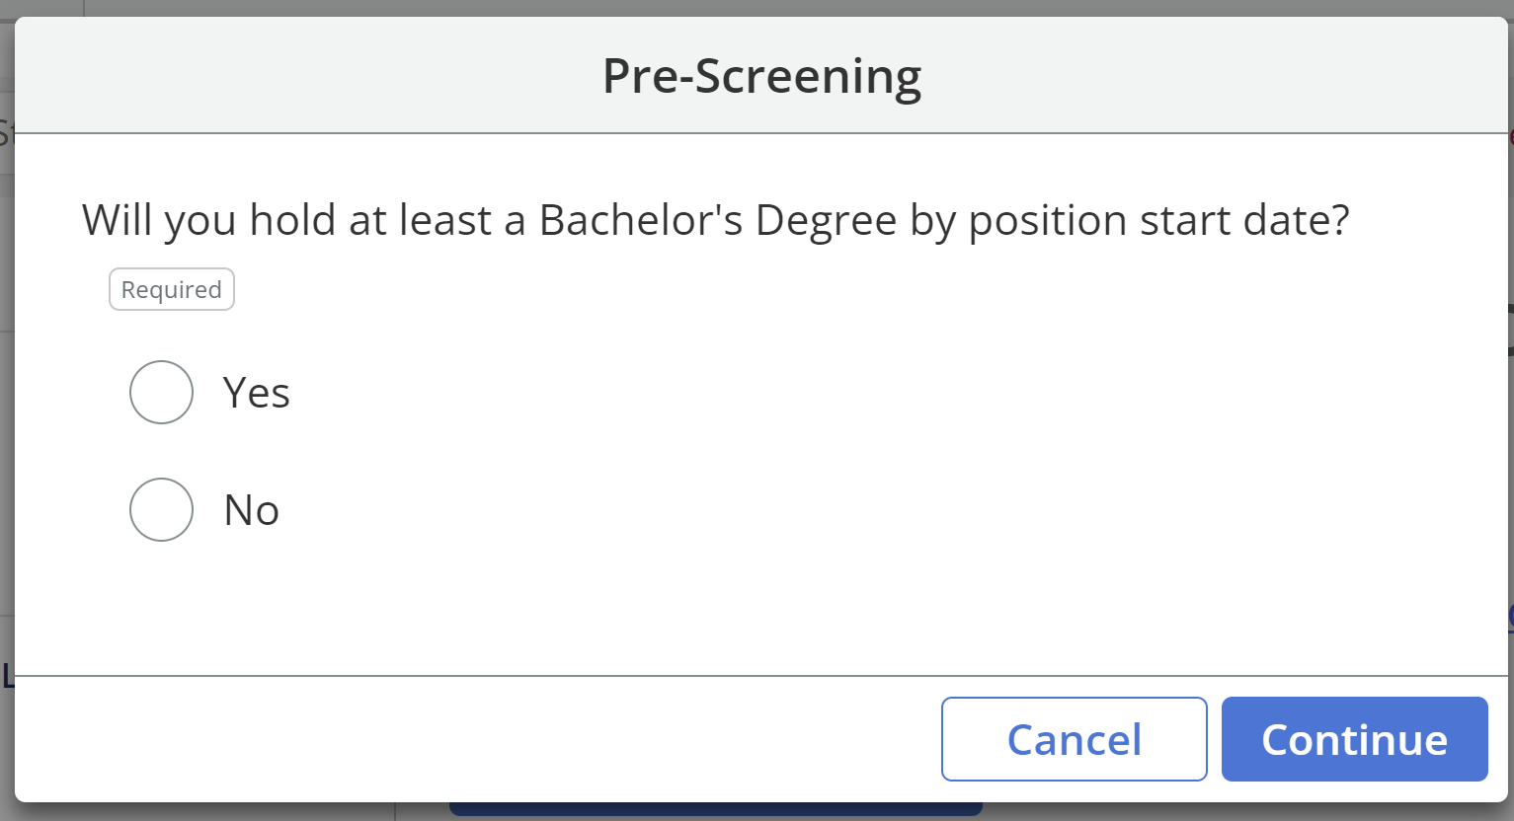
If you set up your profile in advance, some of the information you entered will auto-populate when you go to apply for the position. Select the Save button after each section, then select Next. You MUST upload your resume, and any relevant materials you would like to provide for EACH position applied to.
When you find a position you are interested in you are ready to apply. Click on the apply button from the individual job description.
Some jobs will ask a Pre-Screening question. Answer truthfully then select Continue.

Slide 15
NEXT STEPS

Slide 16
NEXT STEPS IN THE PROCESS
Check the My Jobs section to view all positions you have applied to and the associated job descriptions
When invited to interview you can select the time that works best for you from the available options.

Slide 17
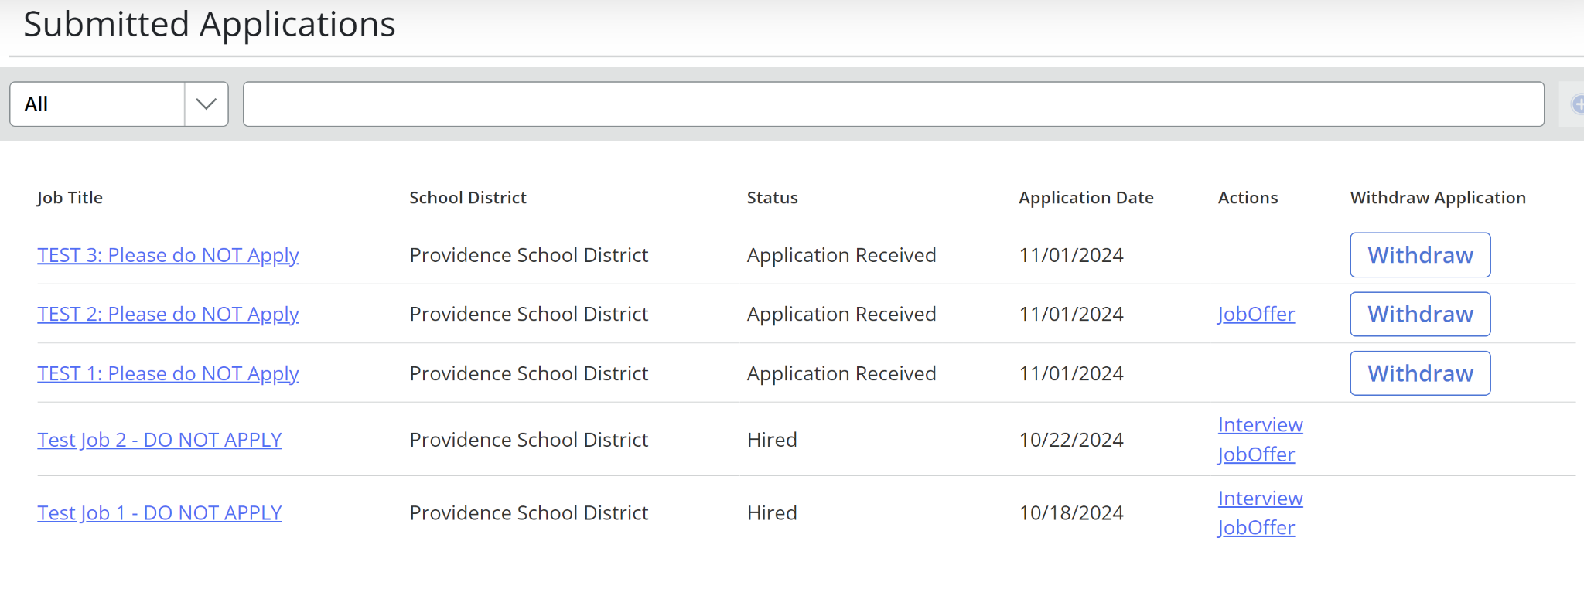
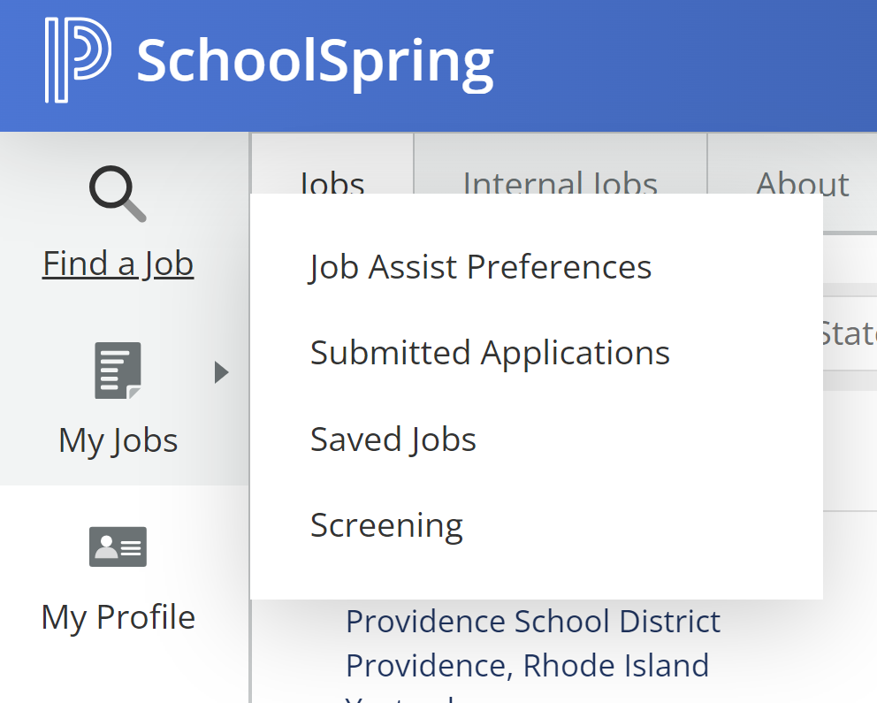
YOUR APPLICATION DASHBOARD
The Submitted Applications view will show you all positions you have applied to and will also show you any incomplete entries. To review the job description prior to any interviews you can click on the blue position title and you can access the job description.
You can also see any pending actions you need to take like schedule an interview, or accept a job offer.

Slide 18
If you still need assistance, please submit a ticket via the Human Resources Let’s Talk Menu here:
https://www.k12insight.com/Lets-Talk/embed.aspx?L=PB7R84N8G5LT

